Slide 1
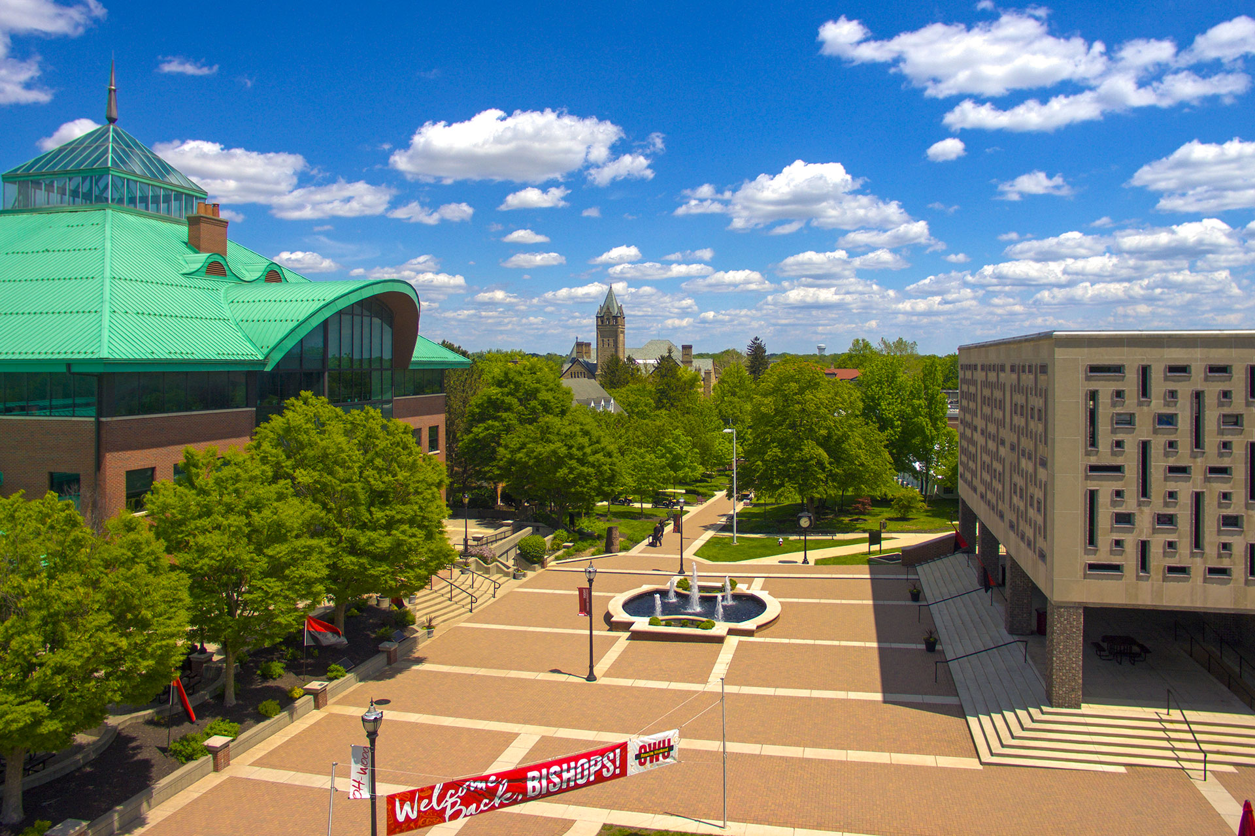
Pitch OWU! Creating a Pitch
The Woltemade Big Problem Challenge

Slide 2
Pitch OWU! Creating a Pitch
Your Challenge:
Use entrepreneurial thinking to improve water quality in the Ohio River and/or Lake Erie. Your plan should rely on a business-focused solution to improve water quality in these bodies of water.
Your proposal may interact with existing regulation and programs, but viability should not depend on new government intervention or assistance.
Notes:
-$3,000 (first), $1,000 (second), $500 (third)

Slide 3
Pitch OWU! Creating a Pitch
Timeline:
Attend the workshop at noon on Jan 30th
Submit proposal by Feb 16th
Committee selects and notifies teams by Feb 20th
Competition on Feb 29th
Notes:
-

Slide 4
Pitch OWU! Creating a Pitch
Criteria:
Feasibility: Is it realistic that you could get this idea off the ground
Sustainability: Does you plan have a means to sustain itself into the future (profitable!)
Adoption: Do you have a clear plan to encourage and grow public adoption of your solution
Impact: What impact do you expect your solution to achieve, and how will you measure it
Research: What research has the team done in development of the plan

Slide 5
Pitch OWU! Creating a Pitch
Approach:
Understand the problem
Choose a small piece of the problem
Start with a canvas
Form a team
Involve a mentor

Slide 6
Pitch OWU! Creating a Pitch
Notes:
https://www.owu.edu/about/follow-owu/stream-owu/special-events/october-25-2023-pitch-owu/

Slide 7
Pitch OWU! Creating a Pitch

Slide 8
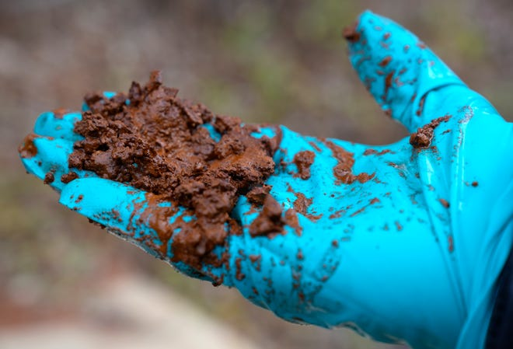
Pitch OWU! Creating a Pitch

Slide 9
Pitch OWU! Creating a Pitch
Notes:
What is the bigger problem?
What are some pieces to the problem?

Slide 10
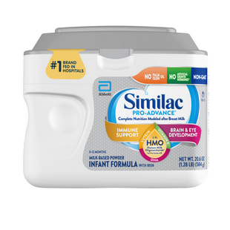
Pitch OWU! Creating a Pitch
Notes:
What is the bigger problem?
What are some pieces to the problem?

Slide 11
Pitch OWU! Creating a Pitch
Notes:
What is the bigger problem?
What are some pieces to the problem?

Slide 12
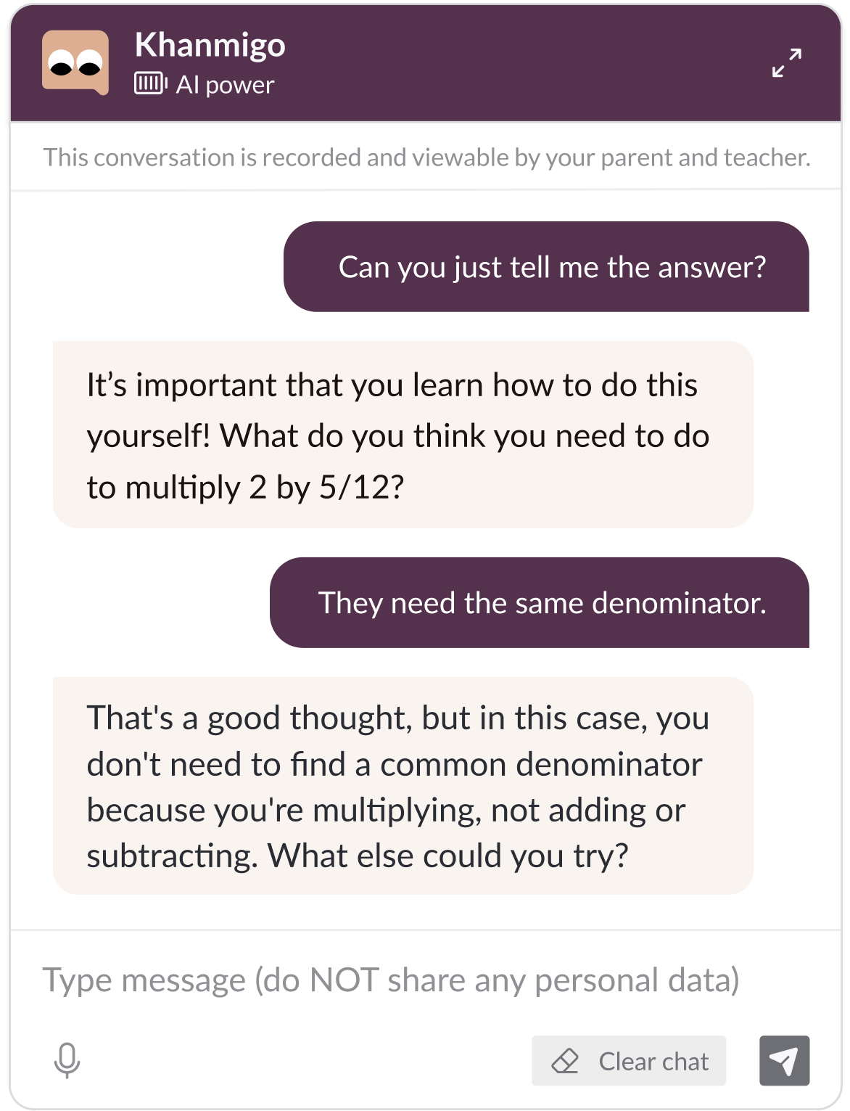
Pitch OWU! Creating a Pitch
Notes:
What is the bigger problem?
What are some pieces to the problem?
-who are you selling too? (individuals, businesses, schools, governments, etc.)
-khanmigo requires a “donation”

Slide 13
Pitch OWU! Creating a Pitch
Notes:
-interact with existing programs/laws
-target different consumer groups

Slide 14
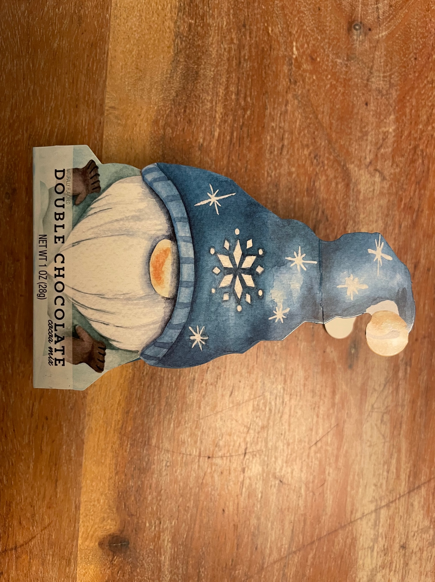
Pitch OWU! Creating a Pitch
Notes:
-interact with existing programs/laws
-target different consumer groups

Slide 15
Format
Five minutes to pitch your idea
Five minutes for judges’ questions

Slide 16
Resources to Help You Prepare:
Business Model Canvas
Lean Business Canvas
Examples in worksheet

Slide 18
Review and discuss
What’s your idea and why does it matter?
Who is it for?
How will you reach them?
How will you make $?

Slide 19
Score
Scale of 1 to 3
3 – This will work!
1 – I’m not so sure this will work.
Score for:
Environmental impact
Business viability
Sort ideas highest to lowest, discuss

Slide 20
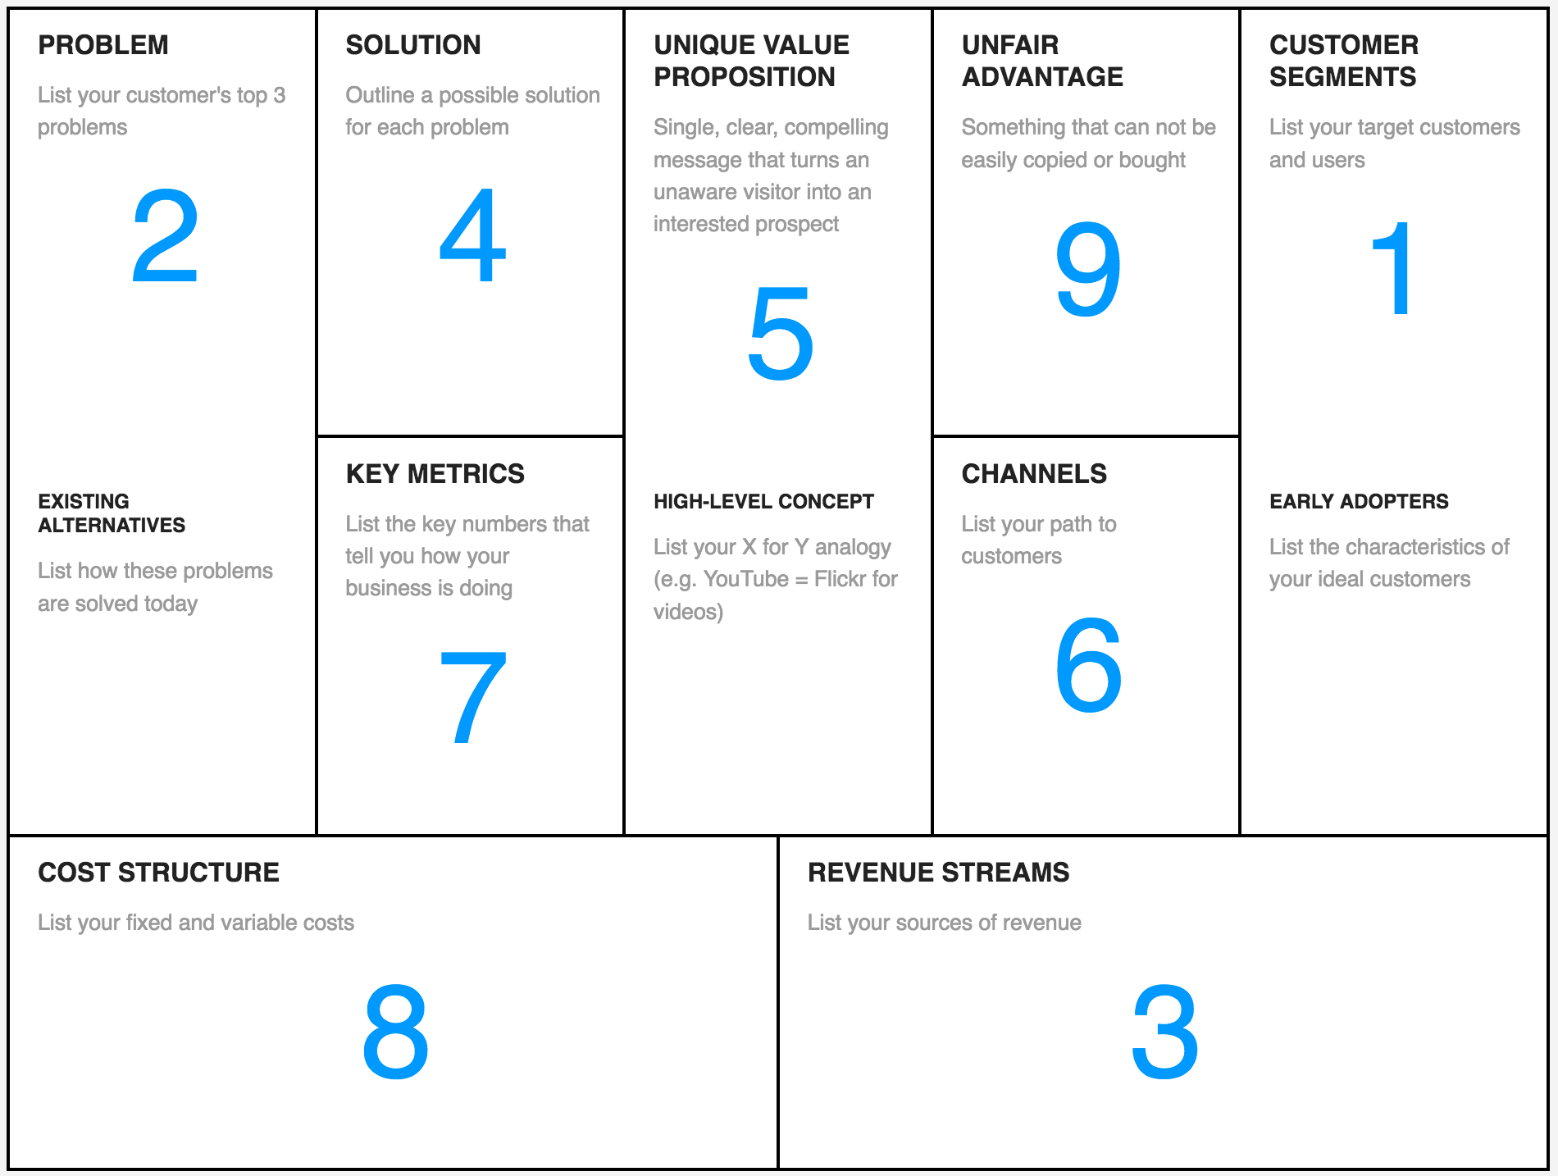

Slide 21
Cost Structure & Revenue
Startup costs (one time expenses to launch)
Fixed costs (must pay no matter what)
Variable costs (change as you sell more/less)
Price per unit

Slide 22
Break-Even Point
BEP = (Fixed Costs + Startup Costs) / (Price per Unit – Variable Cost per Unit)

Slide 23
Example: Coffee Stand
Startup costs:
Equipment: $5,000
Fixed costs:
Rent for 1 year: $10,000
Variable costs
Cups, ground coffee, additives, etc: $0.50 per unit
Planned price
$2 per cup

Slide 24
Break-Even Point = (Startup Costs + Fixed Costs) / (Price per Unit – Variable Cost per Unit) | Calculation | Amount
Startup Costs |  | $5,000
Fixed Costs | + | $10,000
 | = | $15,000
Price per Unit |  | $2
Variable cost per unit | - | $0.50
 | = | $1.50
$15,000 / $1.50 = 10,000 cups of coffee in a year to break even

Slide 25
Next steps
Assign an idea to each group member
Research and estimate costs for your idea
Attempt to calculate BEP, place it in context

Slide 26
Next Steps
Understand the problem
Choose a small piece of the problem
Start with a canvas
Form a team
Involve a mentor

Slide 27
Prep for the Pitch
Keep your slides simple with minimal text.
Practice and time your presentation.
The better you research and understand your idea, the easier it will be to talk about it.
Try you best! There is support available to launch well-developed plans.

Slide 28
Extras
Use AI to draw a prototype
Use AI to apply conceptual tools to your idea:
SWOT
Optimize 4Ps
Describe consumer decision journey
Apply MECE principle to your business idea (repeat)

