Slide 1
Ohio Wesleyan University in Tanzania Program
September 7th – December 9, 2023
The Director of the Program is Dr. Randolph Quaye, Professor and Department Co-Director of the Africana, Gender, Identities Studies Department at Ohio Wesleyan University. Professor Quaye has many years of experience directing international programs, having recently directed programs in Kenya, Zimbabwe and Tanzania. This semester long study program is recommended for students interested in medical systems, the status of women, economic development in social policy. All courses are taught in English (with the exception of Swahili). The Ohio Wesleyan University in Tanzania program and social policy Affiliated with the University of Dar Es Salaam and the School of St. Jude.
Academic Program
The tentative schedule of field experiences for the Program are as follows :
Week 1 : Arusha ( Tanzania) Arusha National Park, The Taringire National Park , The International Criminal Tribunal for Rwanda and Tour of Neil Mith Center.
Week 2: Ngorongoro Crater and Olduvai Gorge. Visit to Lake Manyara National Park.
Week 3: Dar Es Salaam (Tanzania) Tour of the city, Mbudia Beach and Bagamoyo
Week 4: Trip to Morogoro, Mikumi and Udzungwa National park.
Week 5: Spring Break and Independent travel
Week 6: Dar Es Salaam
Week 7: Iringa
Week 8: Coastal Tour – Zanzibar
Week 9: Coastal Tour – Zanzibar
Week 10: Arusha

Slide 2
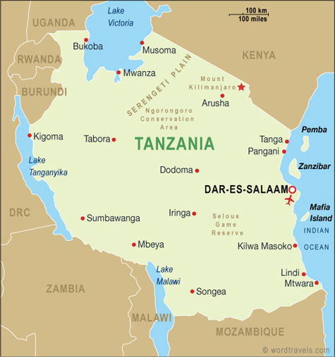
RESIDENTIAL LIFE
Students will stay at the O’Neals in Arusha, Tanzanian host families while in Dar Es Salaam , and Tamarind Hotel in Zanzibar. Rural Homestays will take place in Iringa, Tanzania during the one week that the Program will be located there.
PROGRAM FEES
Participants will be enrolled as students of Ohio Wesleyan University and pay fees to the University. The fees will cover all travels, meals, accommodation and air ticket from Ohio to Tanzania.
DEADLINE FOR APPLICATION
The deadline for the application is April 12, 2023. Students will be notified no later than May 1th, 2023 about the status of their application.
COURSES
Each student will take four classes:
1. East Africa Culture ( BWS 300.3) : Students will examine various East African settings by reading both primary and interpretive texts and visit major historical, cultural and environmental sites. Topics covered would include: migrant labor, class and ethnic structures, human rights and political struggles in relation to externally imposed economic programs.
2. African Medical Systems (BWS 300.5): Students will explore the African concept of health and illness, the social context of illness, construction and deconstruction of illness, role of networks in health care utilization, access to healthcare, cost control and role of non-governmental organizations in the delivery of healthcare services.
3 .Women, Development and the Environment (BWS 300.4): This course is designed to explore gender relations in Africa with a special reference to East African women. Topics covered will include: historical role of women in independent Africa, their role in the formal and informal sectors, population control politics and family planning and recent economic reforms on the welfare of mothers and children.
4. Internship in Tanzania ( BWS 400.2): Students will be linked with a professional social services or research institution, depending on the interest of students. These organizations would include: Tanzanian Family Planning Association, Women Legal Aid Society, Blue Cross of Tanzania, Family Health International, Association of Tanzanian Women Doctors, among many others.
5. Introductory and Intermediate Swahili ( SL 110, 111, 225): This course will help students develop competency in basic and intermediate Swahili.
Dr. Randolph Quaye
Ohio Wesleyan University
rkquaye@owu.edu
740-368-3833
Darrell Albon
Ohio Wesleyan University
djalbon@owu.edu
740-368- 3070
http://bws.owu.edu/tanzania.html

